Slide 1
Ventricular Myocyte Model :
Recalibrating RyR and SERCA Dynamics to reproduce positive Ca-Freq behavior

Slide 2
Can we selectively augment SR pump function at higher frequencies to compensate for lower RyR open fraction?
SERCA 1.5X Vmaxr 2X (Nai clamped at 10 mM)
K52 = 0.00667

Slide 3
How do we see a positive Ca – Frequency relationship at low diastolic Calcium?
RyR Dynamics
Leak has been eliminated by not approaching physiologically unrealistic diastolic Ca concentrations.
Peak RyR open :
1Hz > 2Hz ~ 0.5 Hz
At higher frequencies, higher diastolic Ca leads to lower availability, at low frequencies, despite 100% availability, low peak Ca leads to lower peak open probability.
RyR Flux:
1Hz ~ 2Hz > 0.5 Hz
Although the peak open probability is lower at 2 Hz, higher SR Calcium compensates leading to comparable flux

Slide 4
How do we see a positive Ca – Frequency relationship at low diastolic Calcium?
Intracellular Calcium fluxes

Slide 5
Purkinje Model:
Introducing Spatial Diffusion

Slide 6
Simulating RyR dynamics with clamped calcium protocol – 4 state Keizer- Levine model

Slide 7
Simulating RyR dynamics with imported calcium transients – 4-State Keizer Levine model

Slide 8
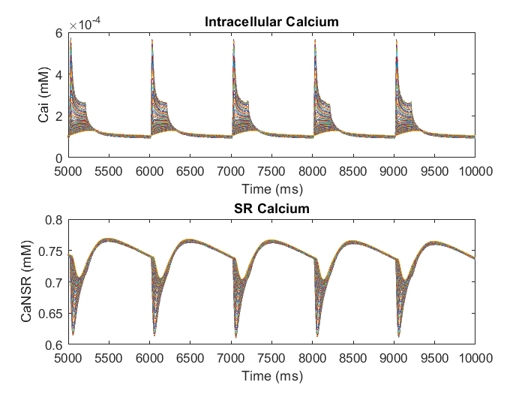
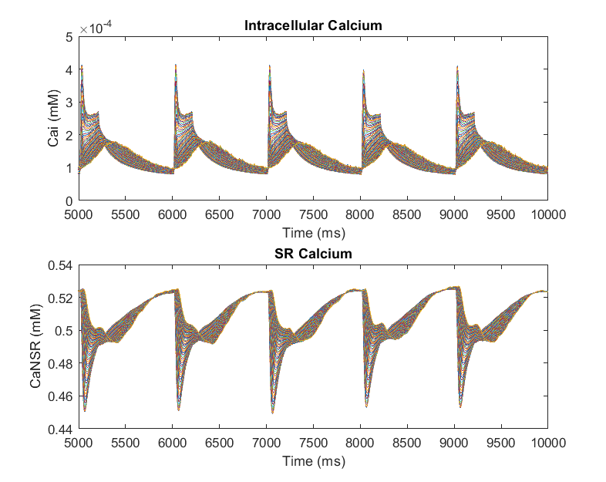
Implementing Keizer-Levine RyR model in the interior shells of the Detubulated model
Simulation Parameters: SERCA 1.5X Vmaxr 2X (Nai clamped at 10 mM) ; K52 = 0.00667
Tubulated Response at 1Hz
Detubulated model with no change to internal RyR dynamics at 1 Hz
Detubulated model with Keizer Levine formulation for internal RyR dynamics at 1 Hz
There is a decrease in both the amplitude of the calcium transients and the SR content with the introduction of modified gating dynamics in the internal shells

Slide 9
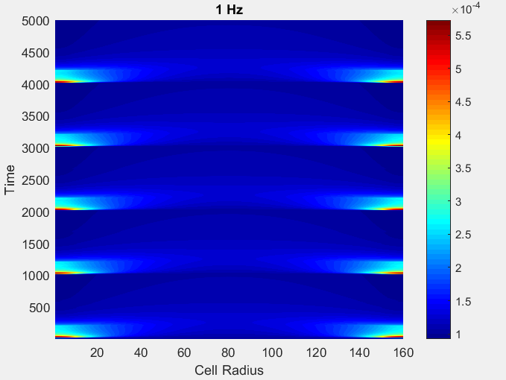
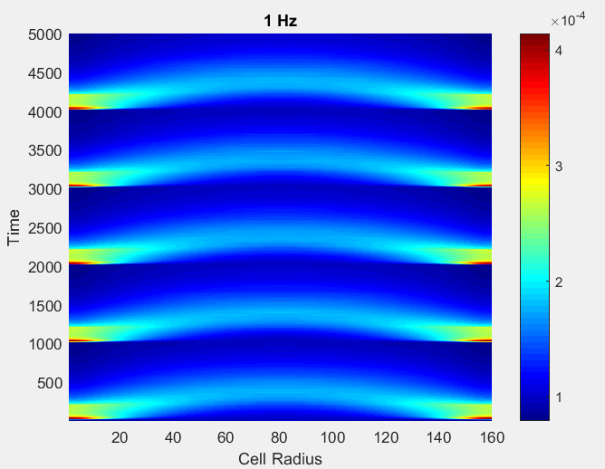
Simulated Line scans before and after internal RyR dynamics were reformulated
Before sensitization
After sensitization

Slide 10
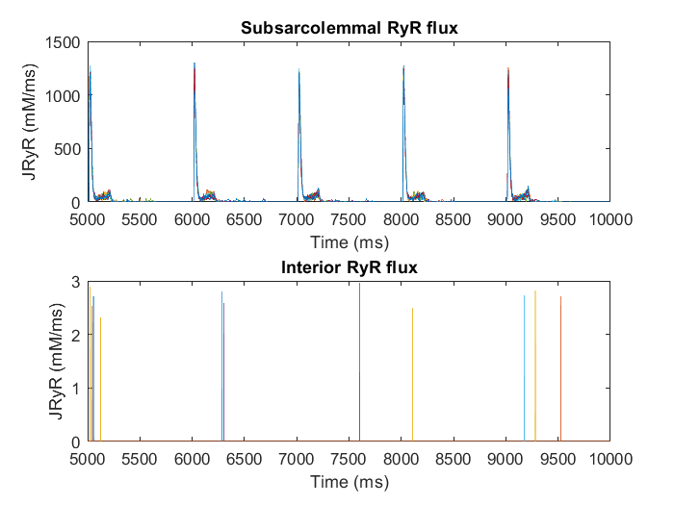
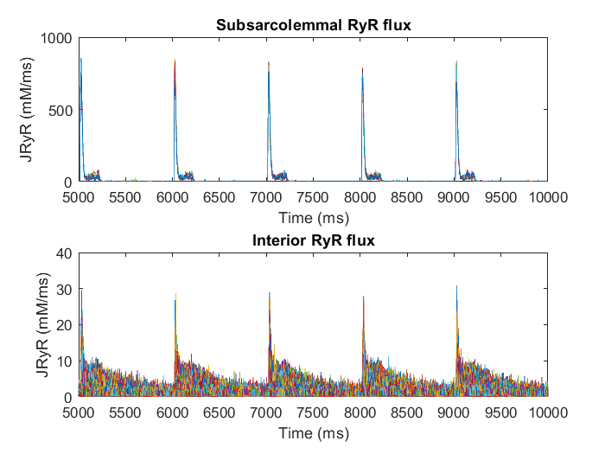
RyR flux in SS and interior
Before recalibrating the RyR dynamics
After recalibrating the RyR dynamics

Slide 11
Average RyR state occupancy in the Sub-sarcolemmal shells and the interior

Slide 12
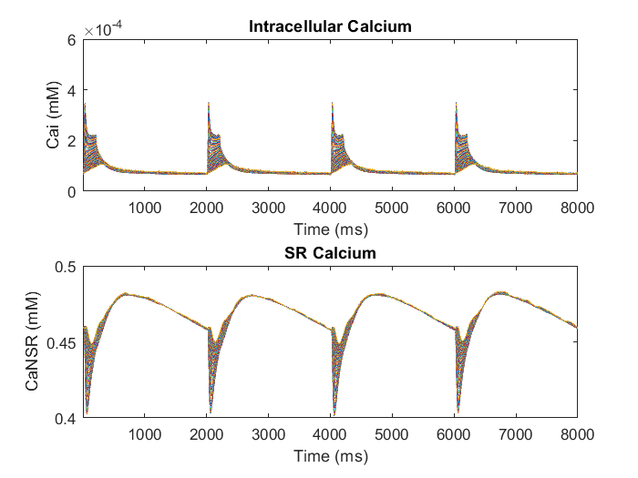
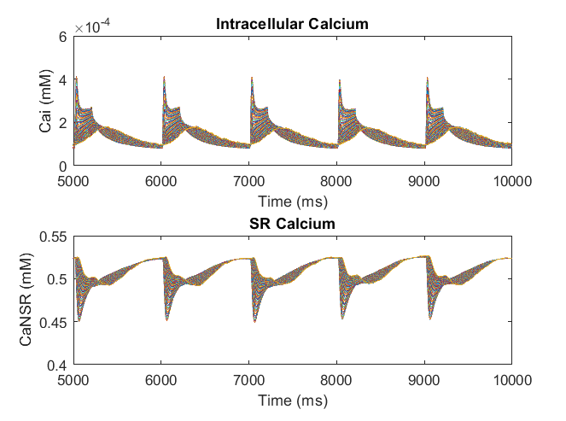
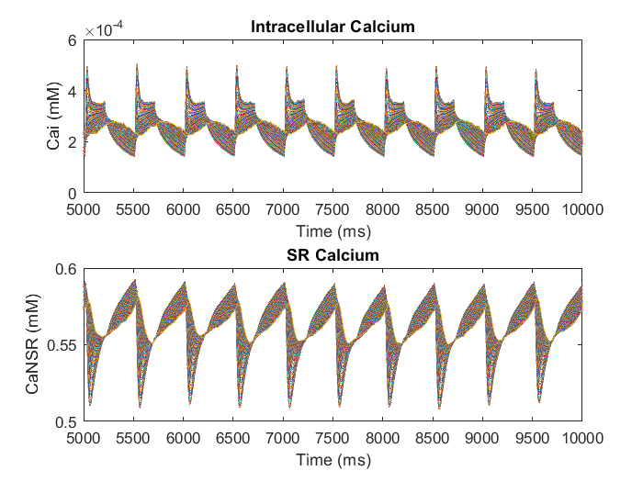
Implementing Keizer-Levine RyR model in the interior shells of the Detubulated model at 0.5 Hz, 1Hz and 2Hz
Calcium transients
0.5 Hz
1 Hz
2 Hz

Slide 13
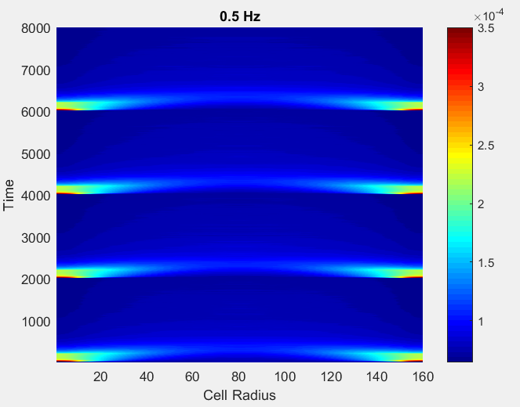
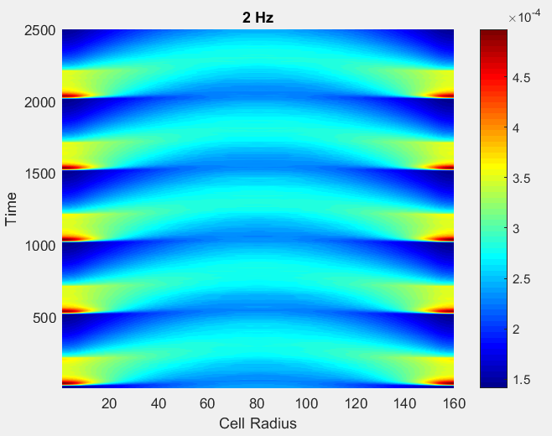
Implementing Keizer-Levine RyR model in the interior shells of the Detubulated model at 0.5 Hz, 1Hz and 2Hz
Simulated line scans. [Normalized by diastolic calcium]
0.5 Hz
1 Hz
2 Hz

Slide 14
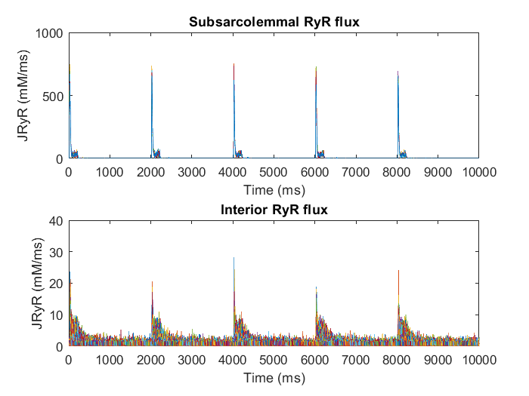
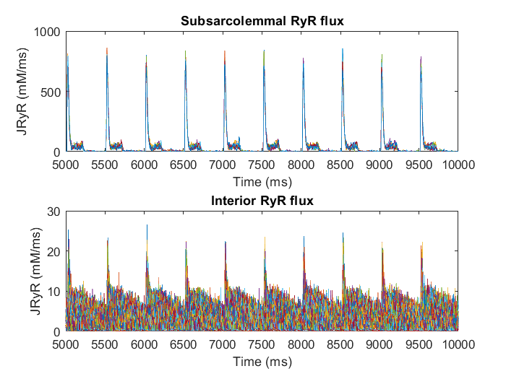
Implementing Keizer-Levine RyR model in the interior shells of the Detubulated model at 0.5 Hz, 1Hz and 2Hz
RyR flux in interior and sarcolemma shells
0.5 Hz
1 Hz
2 Hz

Slide 15
Implementing Keizer-Levine RyR model in the interior shells of the Detubulated model at 0.5 Hz, 1Hz and 2Hz
RyR gate occupancies in the sarcolemma

Slide 16
Implementing Keizer-Levine RyR model in the interior shells of the Detubulated model at 0.5 Hz, 1Hz and 2Hz
RyR gate occupancies in the interior

Slide 17
Implementing Keizer-Levine RyR model in the interior shells of the Detubulated model at 0.5 Hz, 1Hz and 2Hz
Fluxes

Slide 18
Force- frequency relationship : Before and after detubulation

